Slide 1
Procurement Management

Slide 2
Contents
Introduction
Procurement management processes & Process groups
Definitions
Procurement management process
Inputs, Tools & techniques and Outputs
Examples & Good samples
Exercise(s) if applicable
Wrap up

Slide 3
Procurement Management - Introduction
Acquiring Project related resources.
Project Procurement Management is the function through which resources are acquired for the project in order to produce the end product.
It requires the development of a procurement strategy, instituting information systems, identifying potential sources, source selection,contract award and administrating the resulting contract.

Slide 4
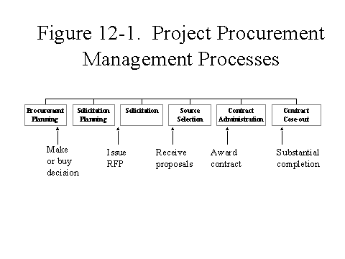
Procurement Management

Slide 5
Procurement Management Cycle

Slide 6
Procurement Management processes (Process groups)
Planning
Procurement Planning
Solicitation Planning
Initiating
NONE
Executing
Solicitations,
Source Selection,
Contract Administration
Controlling
NONE
Closing
Close Out

Slide 7
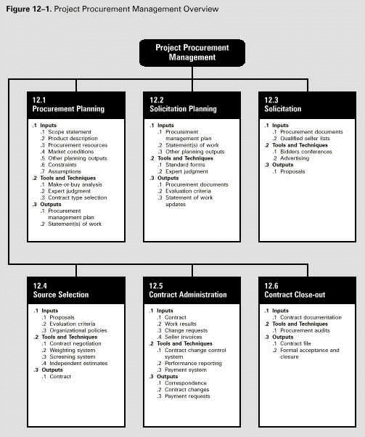
Procurement management processes

Slide 8
Definitions
Procurement Planning -
The process of identifying which project needs can be best met by
procuring products or services outside the organization
Whether/ How / What/ How much/ When to procure.
Procurement Management -
The function through which resources are acquired for the project
in order to produce the end product.
It includes the function of establishing strategy, instituting
information systems, identifying sources, selection, conducting
proposal or tender, solicitation and award and administrating the
resulting contract

Slide 9
Definitions
Acquisition process -
The process of acquiring personnel, goods, services for new or
existing work within the genera definition of contracts requiring an
offer and acceptance, consideration,lawful subject matter and
competent parties.
Purchase -
Outright acquisition of items, mostly off the shelf or catalog,
manufactured outside the purchaser premises.

Slide 10
Procurement
Discussed from the perspective of the buyer in the Buyer-Seller relationship.
Buyer becomes the customer and is thus a key stakeholder for the seller
Sellers project management team must be concerned with all the processes.
Terms and conditions of the contract become a key input to the many of the seller’s processes.

Slide 11
The Procurement process
Planning.
Define Requirements
Bidder’s list
RFP or RFQ
Execution
Bid,proposal or Quotation
Bid Analysis
Negotiation
Contract Execution
Contract Close-out.

Slide 12
Procurement planning /Requirement cycle
Defining the need of the project
Development of SOW, Specifications, WBS
Performing make / Buy analysis
Laying major milestones and schedule
Cost estimating
Obtain authorization
SOW- Is a narrative description of the work to be accomplished and or the resources to be supplied
Specifications can be pictorial, written or graphic

Slide 13
Procurement Planning
INPUT
Tools &
Techniques
Output
Scope statement
Product description
Procurement resources
Market conditions
Other planning outputs
Constraints
Assumptions
Make or buy analysis
Expert Judgement
Contract type selection- Fixed price, cost, Reimbursable, Unit Price
Procurement Management Plan
Statement of work

Slide 14
Procurement Management Plan
Defining and establishing the process that aids in
Organizing procurement for the project
Establishing procurement activities and approvals
Selecting and negotiating the types of contracts required for the project
Obtaining independent estimates for evaluation
Establishing acceptable make or buy decision
Controlling the execution of the contract
Managing changes to contract
Providing orderly close out

Slide 15
Procurement Alternatives
Alternatives.
Make or Buy
Lease or Rent
Lease or Buy
Organization
Centralized or Decentralized
Preferential.
Buy International or Domestic

Slide 16
Make or Buy Analysis
Make
Cost
Integration of Operations
Idle Existing Capacity
Direct Control
Design Secrecy
Unreliable Suppliers
Stabilize work force
Capital investment
Union Agreements

Slide 17
Make or Buy Analysis
Buy
Cost
Suppliers skills
Small volume requirements
Limited Capacity
Augment Labor force
Unreliable Suppliers
Maintain Multiple sources
Risk sharing

Slide 18
Contract
A mutually binding agreement which obligates the seller to provide the specified products and obligates the buyer to pay for it.
May be formal or informal
Highly detailed or broadly framed
Generally falls in to one of the three broad categories
Fixed price
Cost Reimbursable
Unit Price

Slide 19
Contract Types
CR- Cost reimbursable
T&M - Time and Material
Fixed Price
Purchase order
Factors influencing the contract selected
How well-defined the scope of work is or can be
The amount or frequency of changes expected after the project starts
The level of effort and expertise the buyer can devote to managing the supplier
Industry standards of the type of contract used

Slide 20
CR- Cost reimbursable
Supplier’s cost are reimbursed
Buyer has higher risk if cost is not known
Used when the buyer can describe what is needed
Different types of reimbursable contracts are
CPFF- Cost plus Fixed fee
eg : Contract = cost plus a fee of Rs.1 lakh
CPPC - Cost plus percentage of cost
eg: Contract = cost plus 10% of costs as fee
CPIF - Cost plus incentive fee
eg: Contract = Cost plus a fee of 1 lakh. For every early delivery supplier receives an additional amount.

Slide 21
Time and Material
Usually for smaller amounts.
Risk for the buyer is less.
Contract is best when buyer is not sure as what he wants.
Should not be used for long term project as incentive is less for the supplier
Eg: Contract = $100 per hour plus expenses or materials at cost of $5

Slide 22
Fixed Price
Most common form of contract.
One price is agreed for all work.
Buyer has least risk.
Supplier to be concerned about the work in this type of contract
FPIF - Fixed Price Incentive Fee
FPEPA- Fixed Price Economic Price Adjustment

Slide 23
Example
CPPF Actual Cost + Fee
140000+14000=154000
CPIF Actual cost + Fee (Firm) + Incentive (20% of 10000)
140000+15000+200 = 157000
CPFF Actual cost + fixed price
140000+15000=155000
FPPI Cost+fee+Incentive (1% of 165000)
150000+15000+16500 = 181500
FPIF Cost+Fee+Incentive (20% of 10000)
140000+15000+2000 =157000
FFP Cost Estimate+ Fee %+ Risk assumption (10%)
150000+15000+15000=180000

Slide 24
Contract type- versus risk

Slide 25
Purchase Order
A form of contract that is normally unilateral instead of bilateral. It is usually used for simple commodity procurements
Discuss advantages and disadvantages of each contract form.
Risk and Contract types

Slide 26
Solicitation Planning
INPUT
Tools &
Techniques
Output
Procurement Documents
Qualified Seller Lists
Bidder Conference
Advertising
Proposals

Slide 27
Solicitation Planning
Translate requirements, SOW, specifications to Procurement documents
Procurement documents
Used to solicit proposals from prospective bidders
Request for Quotation/Invitation for Bid (RFQ/IFB)
Request for Proposal
Procurement documents may consist of the following parts
Information for suppliers
Scope of work
Proposed terms and conditions of the contract
Identify a list of prospective bidders/sellers
Management approach

Slide 28
Solicitation
Arrive at evaluation criteria for responses/proposals
Overall understanding of need
Cost
Technical capability
Obtaining information (responses to requests, bids and proposals) on how project needs can be met
No cost to the project (effort expended by sellers in preparing the proposals)
Bidder Conferences - To ensure all sellers have clear common understanding of the project need and clarifying queries that they may have
Advertising - Expanding seller base

Slide 29
Qualified Supplier List
Used in conjunction with any type of procurement.
Meeting with prospective suppliers to make sure that they have understood the requirement
Gives clarity about the scope of work.
These meetings are very important.

Slide 30
Bidders Conference
Used in conjunction with any type of procurement.
Meeting with prospective suppliers to make sure that they have understood the requirement
Gives clarity about the scope of work.
These meetings are very important.

Slide 31
Source Selection
INPUT
Tools &
Techniques
Output
Proposals
Evaluation Criteria
Organizational Policies
Contract Negotiation
Weighting System
Screening System
Independent Estimates
Contract

Slide 32
Source Selection
Application of evaluation criteria to evaluate responses/proposals
Contract negotiation
Weighting System
Screening System
Independent estimates
Deciding contract type (risk, cost, urgency, performance, accuracy of estimation, competition etc.)
Contract Issued!!!
A contract is a mutually binding agreement which obligates the seller to provide a specified product / service and obligates the buyer to pay for it.

Slide 33
Definitions - Source Selection
Source Selection - Choosing among potential contractor - Process of receiving bids and applying evaluation criteria for selection
Apparent low bidder - The contractor who has submitted the complaint bid for all or part of a project as described in a set of bid documents
Best and Final Contract offer - Final offer by the supplier to perform the work after incorporating negotiated and agreed changes in the procurement documents
Bid Evaluation - Review and analysis of response to determine suppliers ability to perform the work as requested

Slide 34
Items - Negotiate
Responsibilities
Authority
Applicable law
Technical and business management approaches
Contract financing
Price

Slide 35
Contract Administration
INPUT
Tools &
Techniques
Output
Contract
Work Results
Change request
Seller invoices
Contract change control system
Performance reporting
Payment system
Correspondence
Contract changes
Payment requests

Slide 36
Definitions
Contract Administration
The process of ensuring that the seller’s performance meets contractual requirements
Managing relationship with seller
Monitoring and control of performance, reviewing progress,making payments, recommending changes etc..
Mediation - The act or process of intervention between conflicting parties to promote reconciliation, settlement or compromise
Arbitration - Arbitration is a means of settling disputes without the need of restoring to the jurisdiction of the courts, by submitting the to arbitrators chosen by the parties.
Litigation - Resolving disputes by means of judicial process.

Slide 37
Contract Close out
INPUT
Tools &
Techniques
Output
Contract documentation
Procurement Audits
Contract File
Formal acceptance and Closure

Slide 38
Contract - Closeout
Product verification (is work complete to satisfaction?) and administrative closure (updating records and archiving)
Structure review of all processes from planning to administration
Contract documentation reviewed.
All pending issues resolved
Formal acceptance and contract closure

Slide 39
Contract - Warranty
Warranty
An act or an instance of warranting; assurance; authorization
A written assurance given to the purchaser of a new appliance, automobile, or other item by the manufacturer or dealer, usually specifying that the manufacturer will make any repairs or replace defective parts free of charge for a stated period of time.
Guarantee
a warrant, pledge or formal assurance given as security that another person’s debt or obligation will be fulfilled
something that is taken or presented as security
the act of giving security
a person who acts as a guarantor.

Slide 40
Contract Types - A few examples
Cost-plus-incentive-fee
Target cost 10,000
Target fee 750
Maximum fee 1,350
Minimum fee 300
Seller share 15%
Buyer share 85%

Slide 41
Contract Types - A few examples
Fixed-price-incentive-fee
Target cost 10,000
Target profit 850
Target price 10,850
Price ceiling 11,500
Seller share 30%
Buyer share 70%

Slide 42
Exercise
What is the best contract type to use in the situations described below
1. You need work to begin right away ---
2.You want to buy expertise in determining what needs to be done--
3. You know exactly what needs to be done --
4. You are buying the services of a programmer to augment your staff ---
5. You do not have the ability to audit invoices --

Slide 43
Conclusion..
Procurement is as important as other aspects of Project Management
A wrongly selected service/product can cost the buyer very heavily
Refine with past experience and lessons learnt
Use checklists while preparing proposals and contracts
Review of legal formalities in a contract
Periodic review of risk areas.

